Slide 1
MongoDB and PostgreSQL

Slide 2
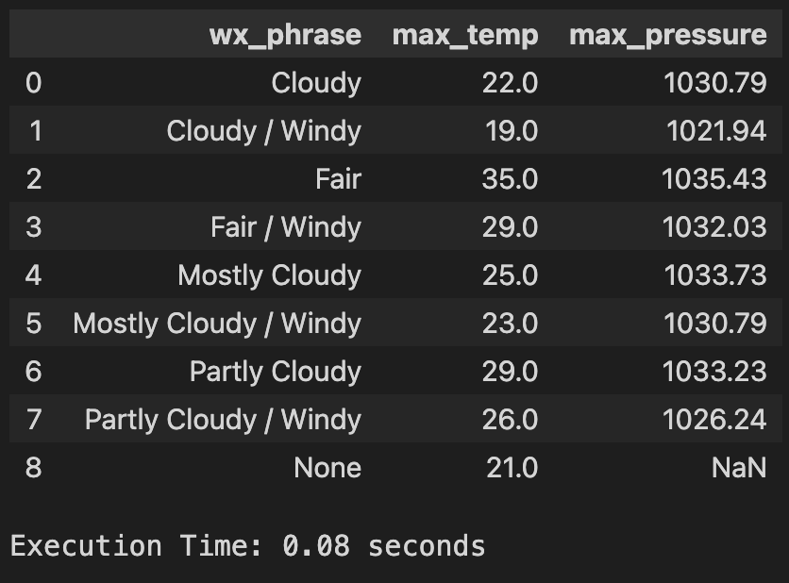
Weather SF – 1 Year weather data
SELECT
wx_phrase,
MAX(temp) AS max_temp,
MAX(pressure) AS max_pressure FROM sf_weather
WHERE
TO_DATE(valid_date_time, 'DD/MM/YYYY HH24:MI:SS') >= '2006-06-01' AND
TO_DATE(valid_date_time, 'DD/MM/YYYY HH24:MI:SS') < '2007-06-01'
GROUP BY wx_phrase
ORDER BY wx_phrase;

Slide 3
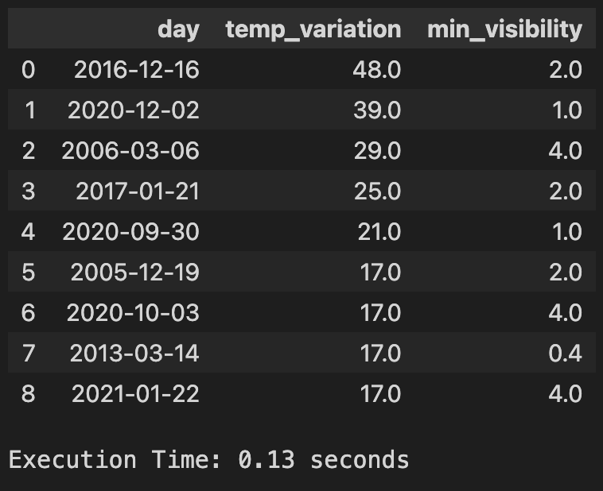
Weather SF - Daily temperature, visibility Analysis
SELECT day,
MAX(max_temp) - MIN(min_temp) AS temp_variation,
MIN(vis) AS min_visibility FROM (
SELECT
TO_DATE(valid_date_time, 'DD/MM/YYYY HH24:MI:SS') AS day,
max_temp,
min_temp,
vis FROM sf_weather) AS DailyData
GROUP BY day
HAVING MAX(max_temp) - MIN(min_temp) > 15 AND MIN(vis) < 5
ORDER BY temp_variation DESC;

Slide 4
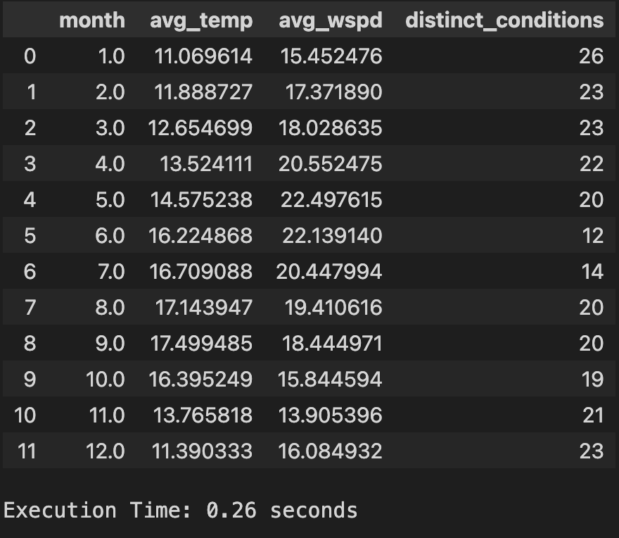
Weather SF - Monthly Average Temperature, Wind Speed with Condition Counts
WITH MonthlyData AS (SELECT
EXTRACT(MONTH FROM TO_DATE(valid_date_time, 'DD/MM/YYYY HH24:MI:SS')) AS month,
AVG(temp) AS avg_temp,
AVG(wspd) AS avg_wspd,
COUNT(DISTINCT wx_phrase) AS distinct_conditions
FROM sf_weather
WHERE
pressure BETWEEN 990 AND 1020
GROUP BY month)
SELECT
month, avg_temp, avg_wspd, distinct_conditions
FROM MonthlyData
WHERE avg_wspd > 10
ORDER BY month;

Slide 5
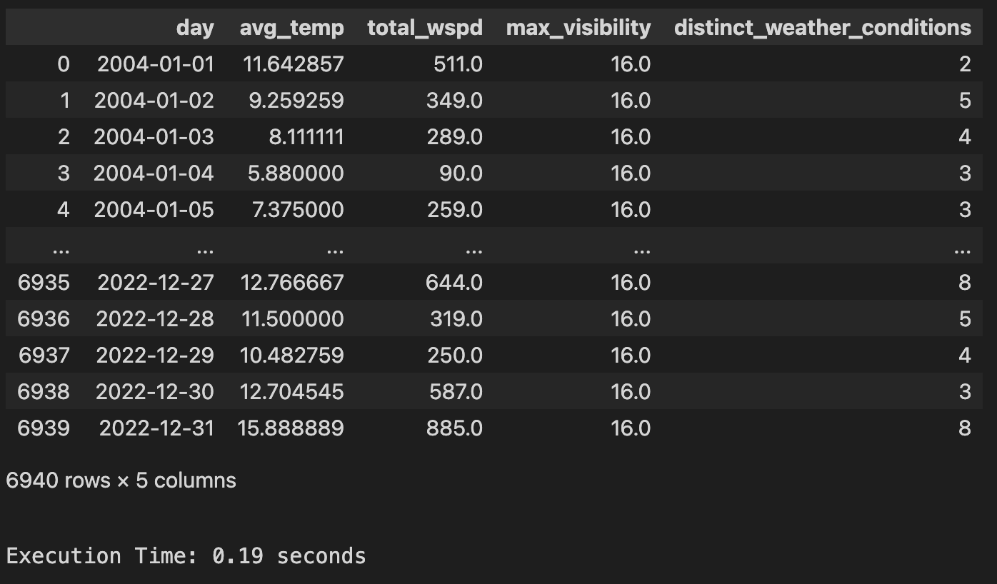
Weather Chicago – Daily avg temp, total wind speed, max visibility, weather condition
SELECT
TO_DATE(valid_date_time, 'MM/DD/YYYY') AS day,
AVG(temp) AS avg_temp,
SUM(wspd) AS total_wspd,
MAX(vis) AS max_visibility,
COUNT(DISTINCT wx_phrase) AS distinct_weather_conditions
FROM sf_weather
GROUP BY day
ORDER BY day;

Slide 6
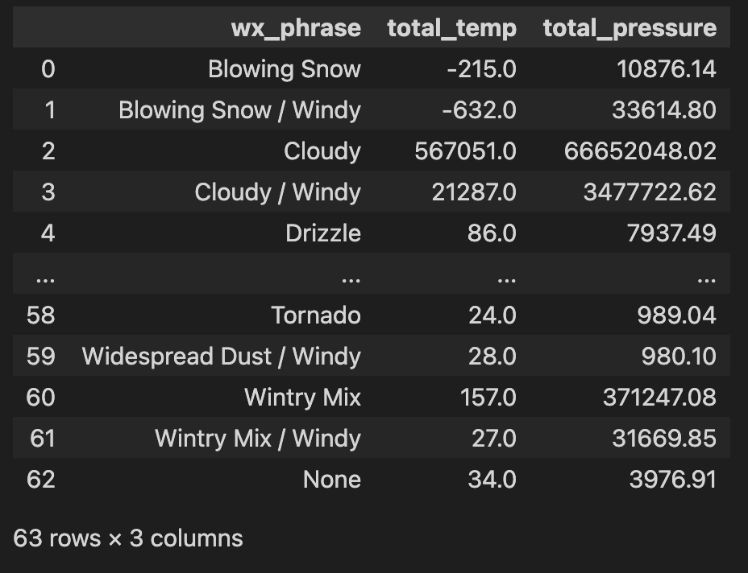
Weather Chicago - Total sum of temperatures and pressures for each distinct weather phrase (wx_phrase)
SELECT
wx_phrase,
SUM(temp) AS total_temp,
SUM(pressure) AS total_pressure
FROM chicago_weather
GROUP BY wx_phrase
ORDER BY wx_phrase;

Slide 7
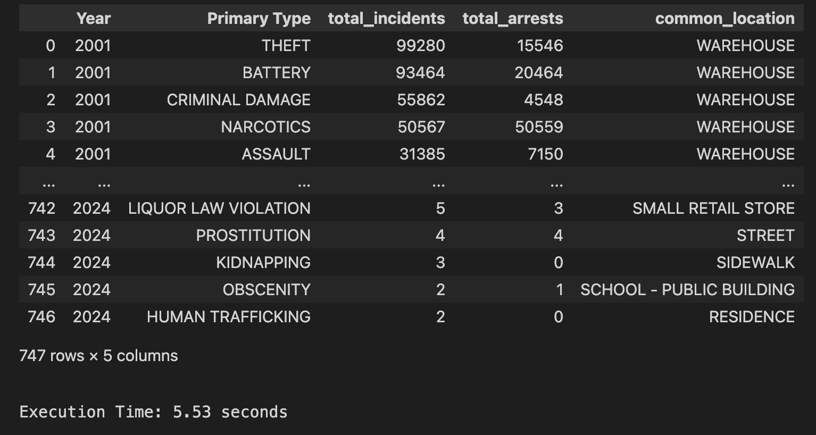
Crime Chicago-Annual Crime Summary by Type
SELECT
"Year",
"Primary Type",
COUNT(*) AS total_incidents,
SUM(CASE WHEN "Arrest" = true THEN 1 ELSE 0 END) AS total_arrests,
MAX("Location Description") AS common_location
FROM chicago_crime
GROUP BY "Year", "Primary Type"
ORDER BY "Year", total_incidents DESC;

Slide 8
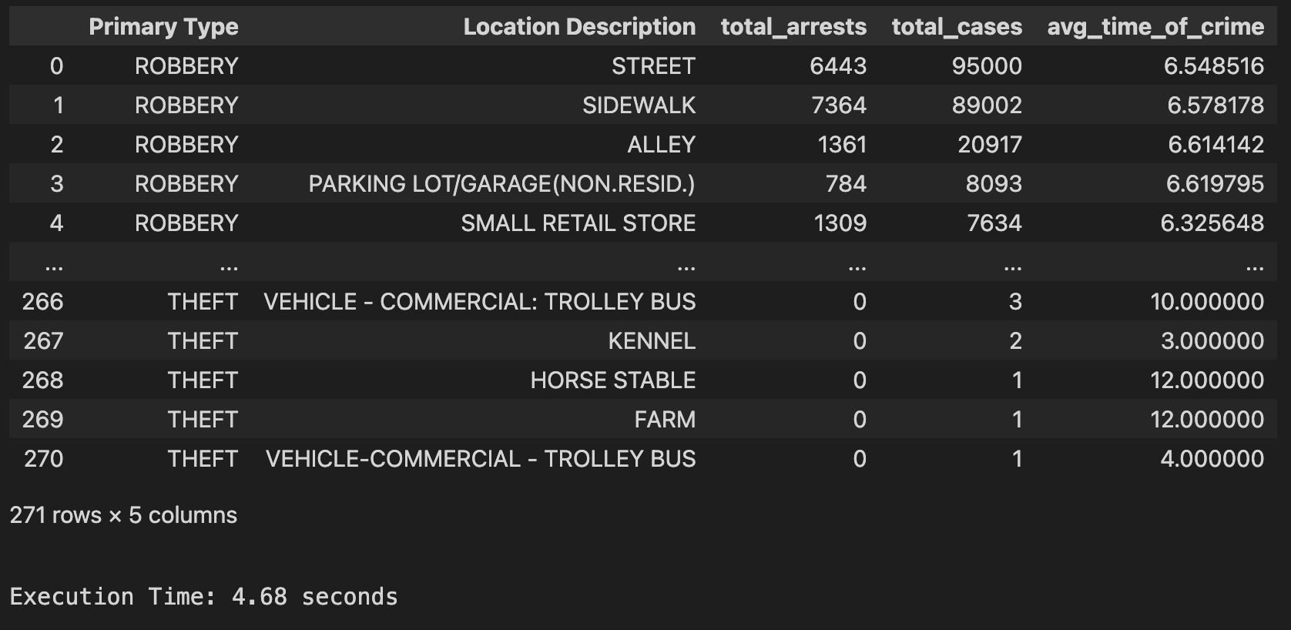
Crime Chicago - Detailed Analysis of Specific Crime Types
WITH CrimeDetails AS (SELECT
"Primary Type",
"Location Description",
"Arrest",
EXTRACT(HOUR FROM TO_TIMESTAMP("Date", 'MM/DD/YYYY HH24:MI:SS')) AS hour
FROM chicago_crime
WHERE "Primary Type" IN ('THEFT', 'ROBBERY’))
SELECT
"Primary Type",
"Location Description",
SUM(CASE WHEN "Arrest" = true THEN 1 ELSE 0 END) AS total_arrests,
COUNT(*) AS total_cases,
AVG(hour) AS avg_time_of_crime
FROM CrimeDetails
GROUP BY "Primary Type", "Location Description"
ORDER BY "Primary Type", total_cases DESC;

Slide 9
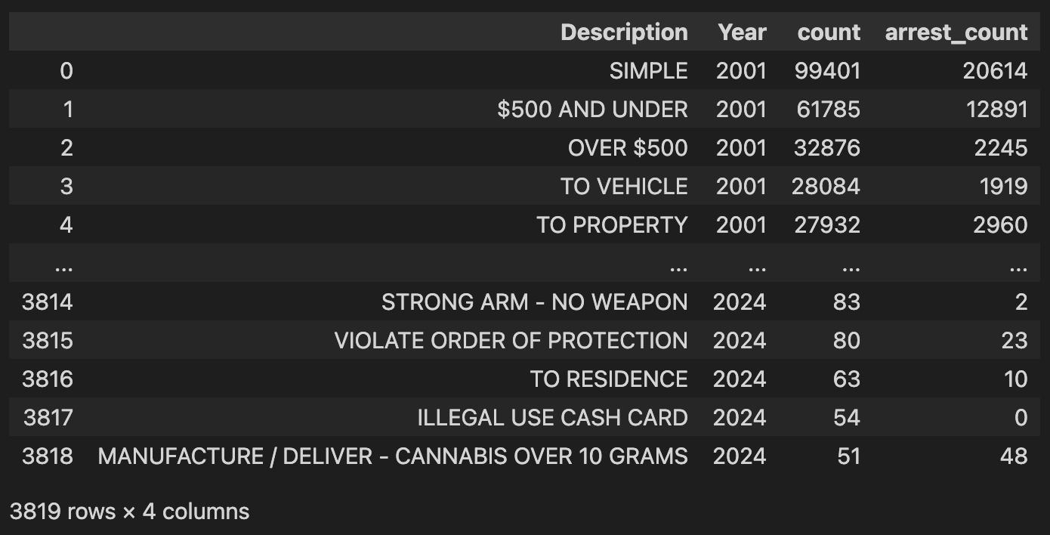
Crime Chicago – Yearly arrest count on different case description types
SELECT
"Description",
"Year",
COUNT(*) AS count,
SUM(CASE WHEN "Arrest" = true THEN 1 ELSE 0 END) AS arrest_count
FROM chicago_crime
GROUP BY "Description", "Year"
HAVING COUNT(*) > 50
ORDER BY "Year", count DESC;

Slide 10





Chicago Crime Data
Size: 7.9 million
Query | Aggregate | MongoDB (seconds) | PostgreSQL (seconds) | MongoDB (seconds) | PostgreSQL (seconds)
No of Columns |  | 0.00 | 0.03 | 0.00 | 0.00
Distinct Years |  | 8.30 | 1.88 | 4.72 | 0.77
Distinct Primary Crime Type |  | 8.47 | 2.82 | 3.44 | 0.72
Distinct Districts |  | 7.29 | 1.90 | 4.22 | 0.71
Per District Crime Count |  | 6.95 | 2.02 | 3.68 | 0.73
Per Primary Crime Type Count |  | 6.91 | 1.87 | 3.01 | 0.71
Per Year Crime Count |  | 7.97 | 2.12 | 4.08 | 0.74
Per Month Crime Count |  | 47.54 | 11.87 | 15.36 | 1.97
Arrest True/False |  | 6.93 | 2.83 | 3.32 | 0.61
Top 10 Locations With Most Cases |  | 6.85 | 3.10 | 3.32 | 0.73
Average Cases A Year |  | 7.29 | 3.12 | 4.10 | 0.74

Slide 11
SF Crime Data
Size: 2.1 million
Query | Aggregate | MongoDB (seconds) | PostgreSQL (seconds) | MongoDB (seconds) | PostgreSQL (seconds)
No of Columns |  |  |  | 0.00 | 0.00
Distinct Years |  |  |  | 2.78 | 0.43
Distinct Category Crime Type |  |  |  | 0.82 | 0.20
Distinct Districts |  |  |  | 1.02 | 0.23
Per District Crime Count |  |  |  | 0.94 | 0.23
Per Category Crime Type Count |  |  |  | 0.74 | 0.21
Per Year Crime Count |  |  |  | 2.85 | 0.43
Per Month Crime Count |  |  |  | 2.84 | 0.43
Weekday Statistics |  |  |  | 0.85 | 0.22
Top 10 Locations With Most Cases |  |  |  | 1.30 | 0.34
Average Cases A Year |  |  |  | 2.82 | 0.43

Slide 12
Chicago Weather Data
Size: 194.3K
Query | Aggregate | MongoDB (seconds) | PostgreSQL (seconds) | MongoDB (seconds) | PostgreSQL (seconds)
Phrases Types |  | 0.19 | 0.12 | 0.08 | 0.03
Phrases Types |  | 0.15 | 0.12 | 0.07 | 0.03
Average Temperature |  | 0.23 | 0.10 | 0.07 | 0.02
Maximum Temperature |  | 0.11 | 0.08 | 0.06 | 0.02
Minimum Temperature |  | 0.16 | 0.08 | 0.06 | 0.02
Maximum Temperature Per Year |  | 1.69 | 0.57 | 0.25 | 0.18
Finding Rows Containing Specific Words |  | 0.53 | 0.40 | 0.12 | 0.12
In A Range Check |  | 0.45 | 0.20 | 0.11 | 0.06
Wind Direction Distribution |  | 0.17 | 0.12 | 0.08 | 0.03

Slide 13
SF Weather Data
Size: 181.9K
Query | Aggregate | MongoDB (seconds) | PostgreSQL (seconds) | MongoDB (seconds) | PostgreSQL (seconds)
Phrases Types |  | 0.28 | 0.15 | 0.08 | 0.02
Phrases Types |  | 0.25 | 0.15 | 0.07 | 0.02
Average Temperature |  | 0.18 | 0.13 | 0.07 | 0.02
Maximum Temperature |  | 0.19 | 0.11 | 0.06 | 0.02
Minimum Temperature |  | 0.13 | 0.12 | 0.06 | 0.02
Maximum Temperature Per Year |  | 1.30 | 1.11 | 0.24 | 0.16
Finding Rows Containing Specific Words |  | 0.66 | 0.98 | 0.11 | 0.09
In A Range Check |  | 0.22 | 0.13 | 0.07 | 0.02
Wind Direction Distribution |  | 0.28 | 0.14 | 0.08 | 0.03

